Slide 1

CCJ
“For years uranium cost only a few dollars a ton until scientists discovered you could kill people with it”
Aman Sharma

Slide 2

Agenda
Recommendation
Macro
Nuclear Fuel Cycle
Industry
Company Description
Mines
Main Risks
Board of Members
Financials & Valuation

Slide 3
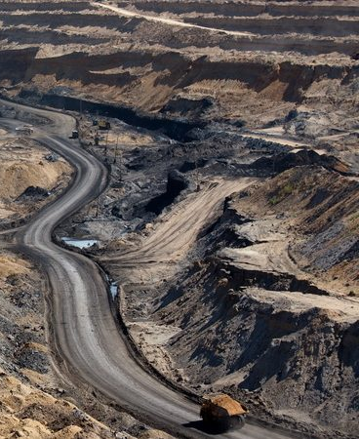
Recommendation: BUY?
Current Price: $44.14
Next 5 year Growth Estimates: 53.25%
Model Price: $38.54
Next 6 year Growth used ≈ 18.36%

Slide 4
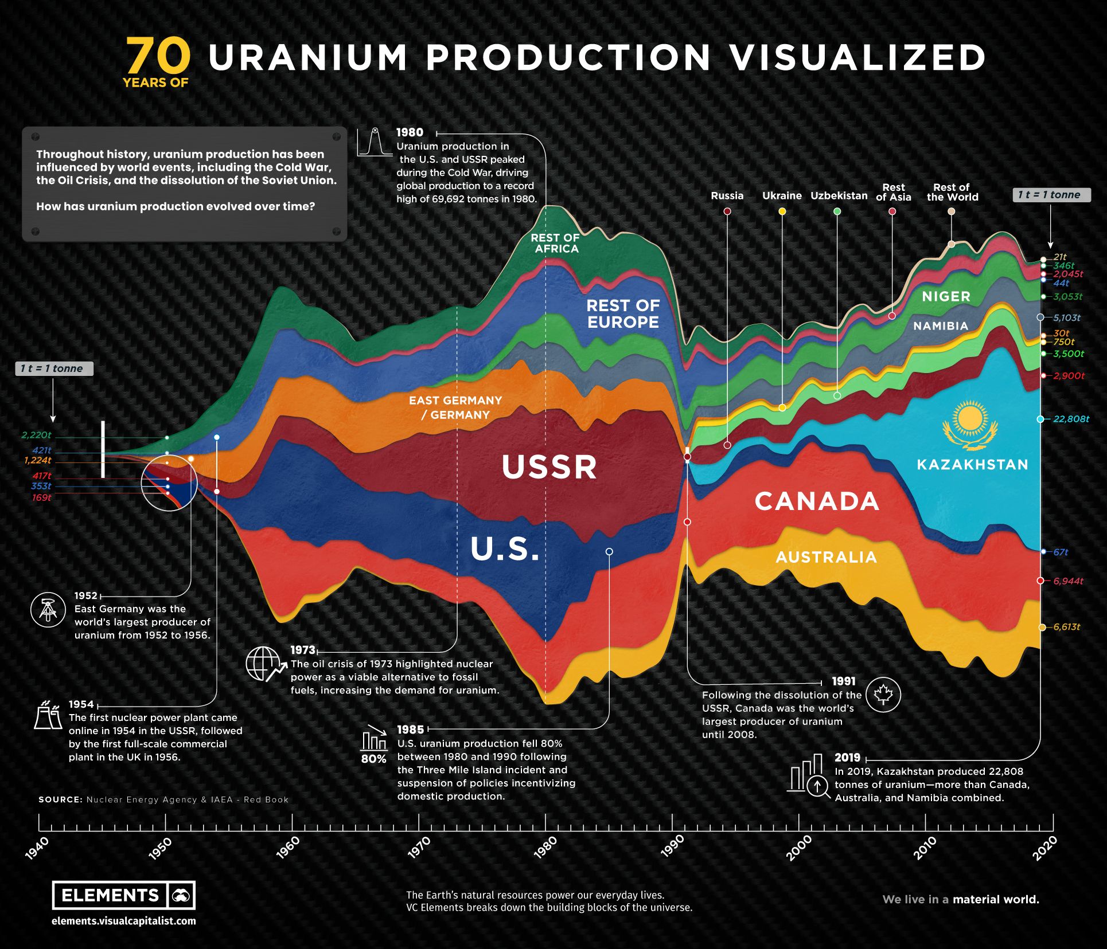

Slide 5
Macro Analysis
Canada & Kazakhstan

Slide 6
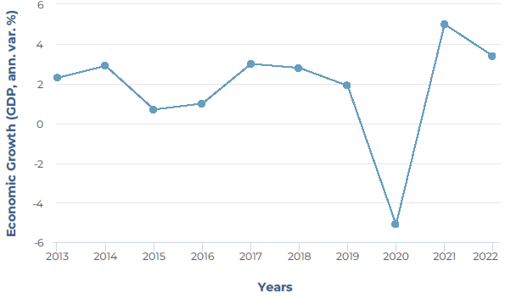
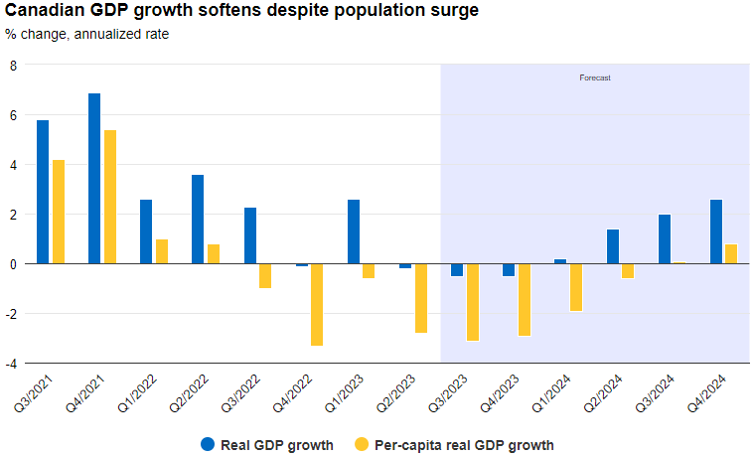
Canada’s GDP

Slide 7
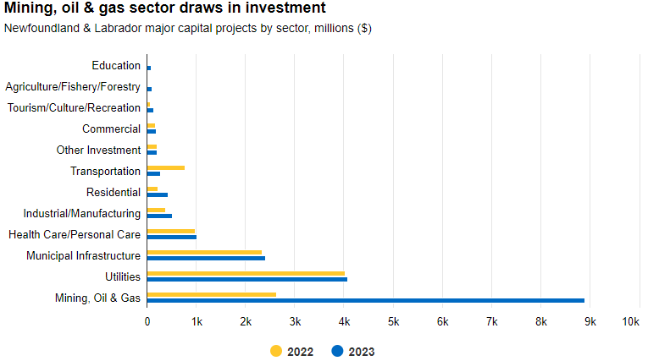

Slide 8
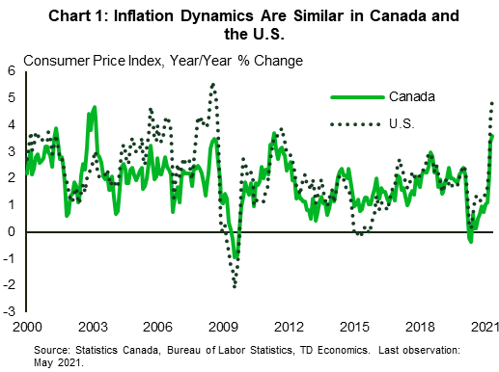
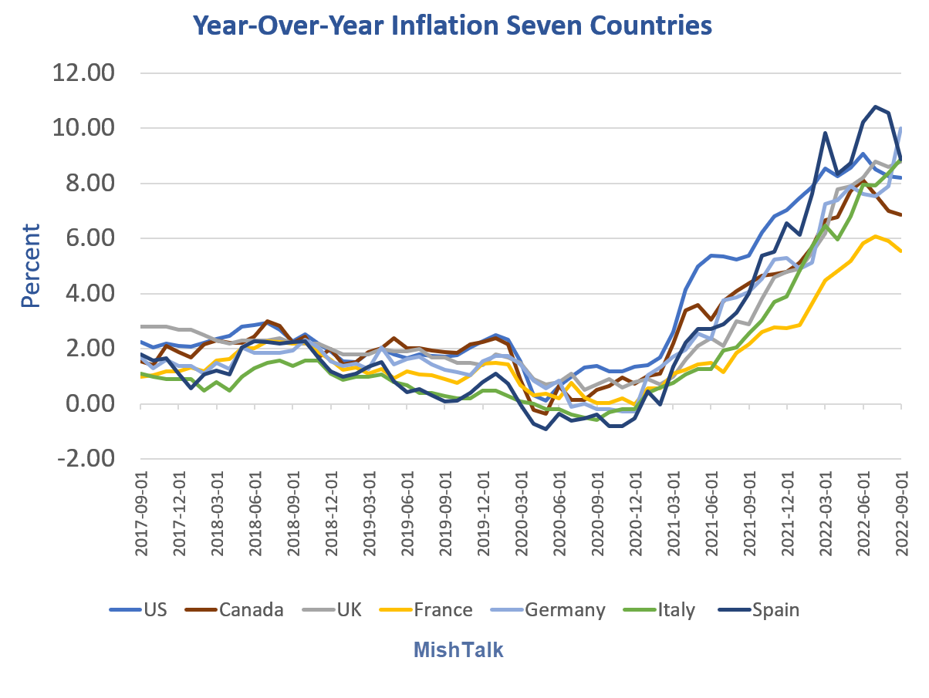
Canada’s Inflation

Slide 9
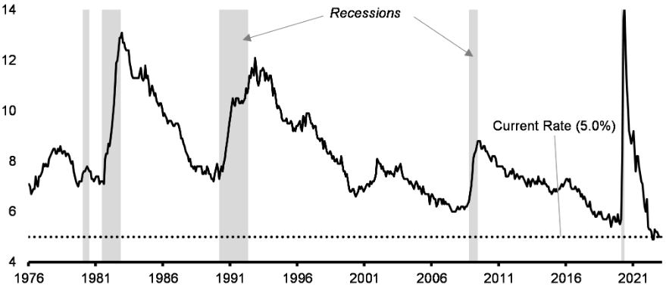
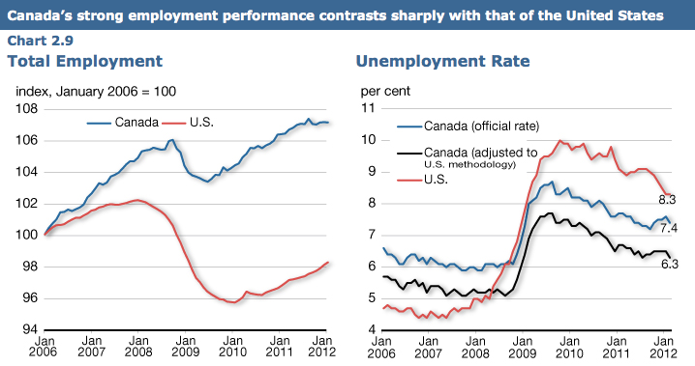
Canada’s Unemployment Rate

Slide 10
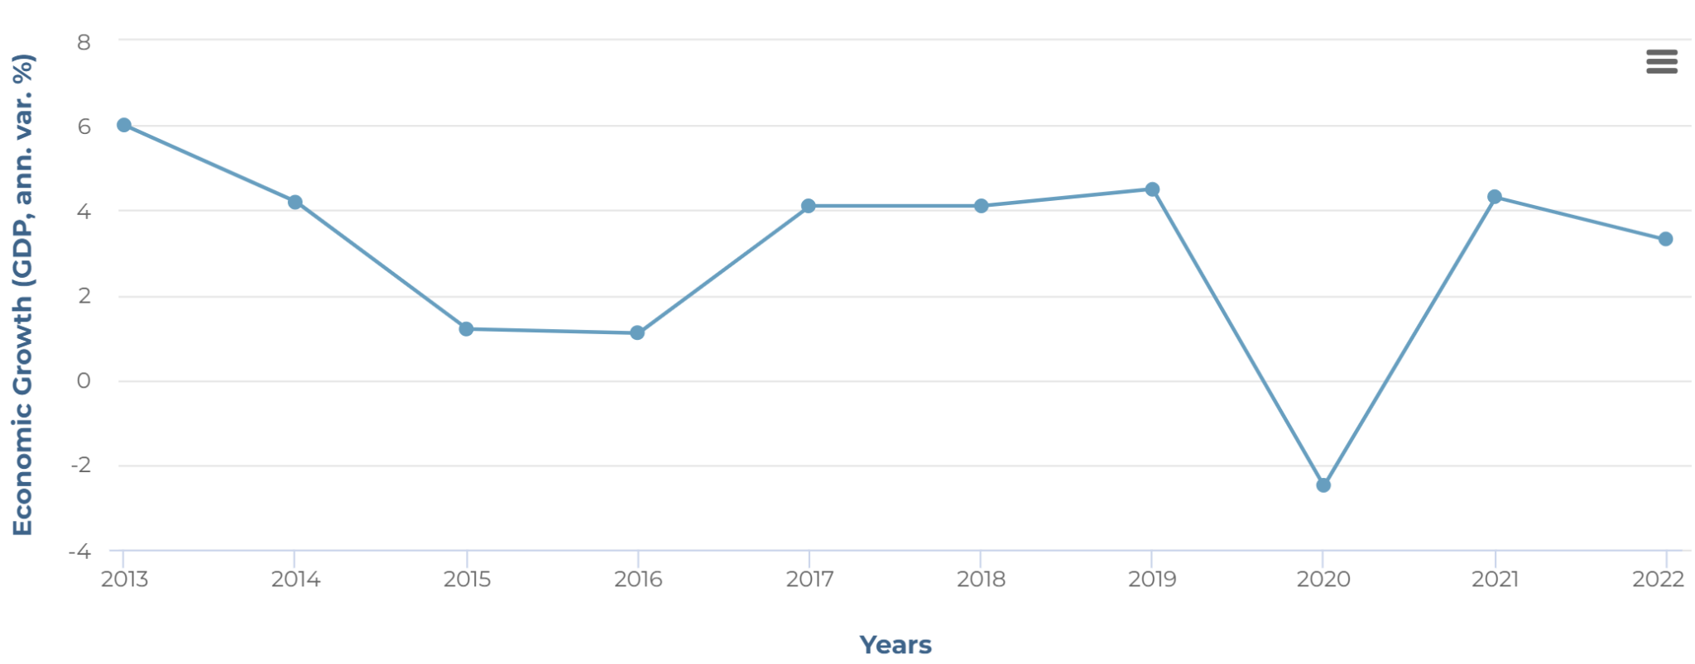
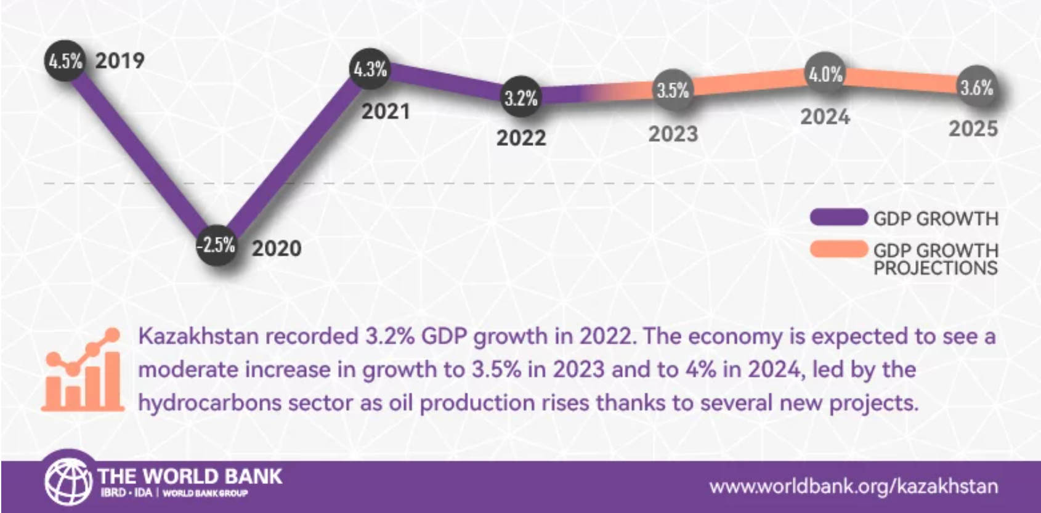
Kazakhstan GDP Growth Past & Future
Notes:
https://www.worldbank.org/en/country/kazakhstan/overview#3

Slide 11
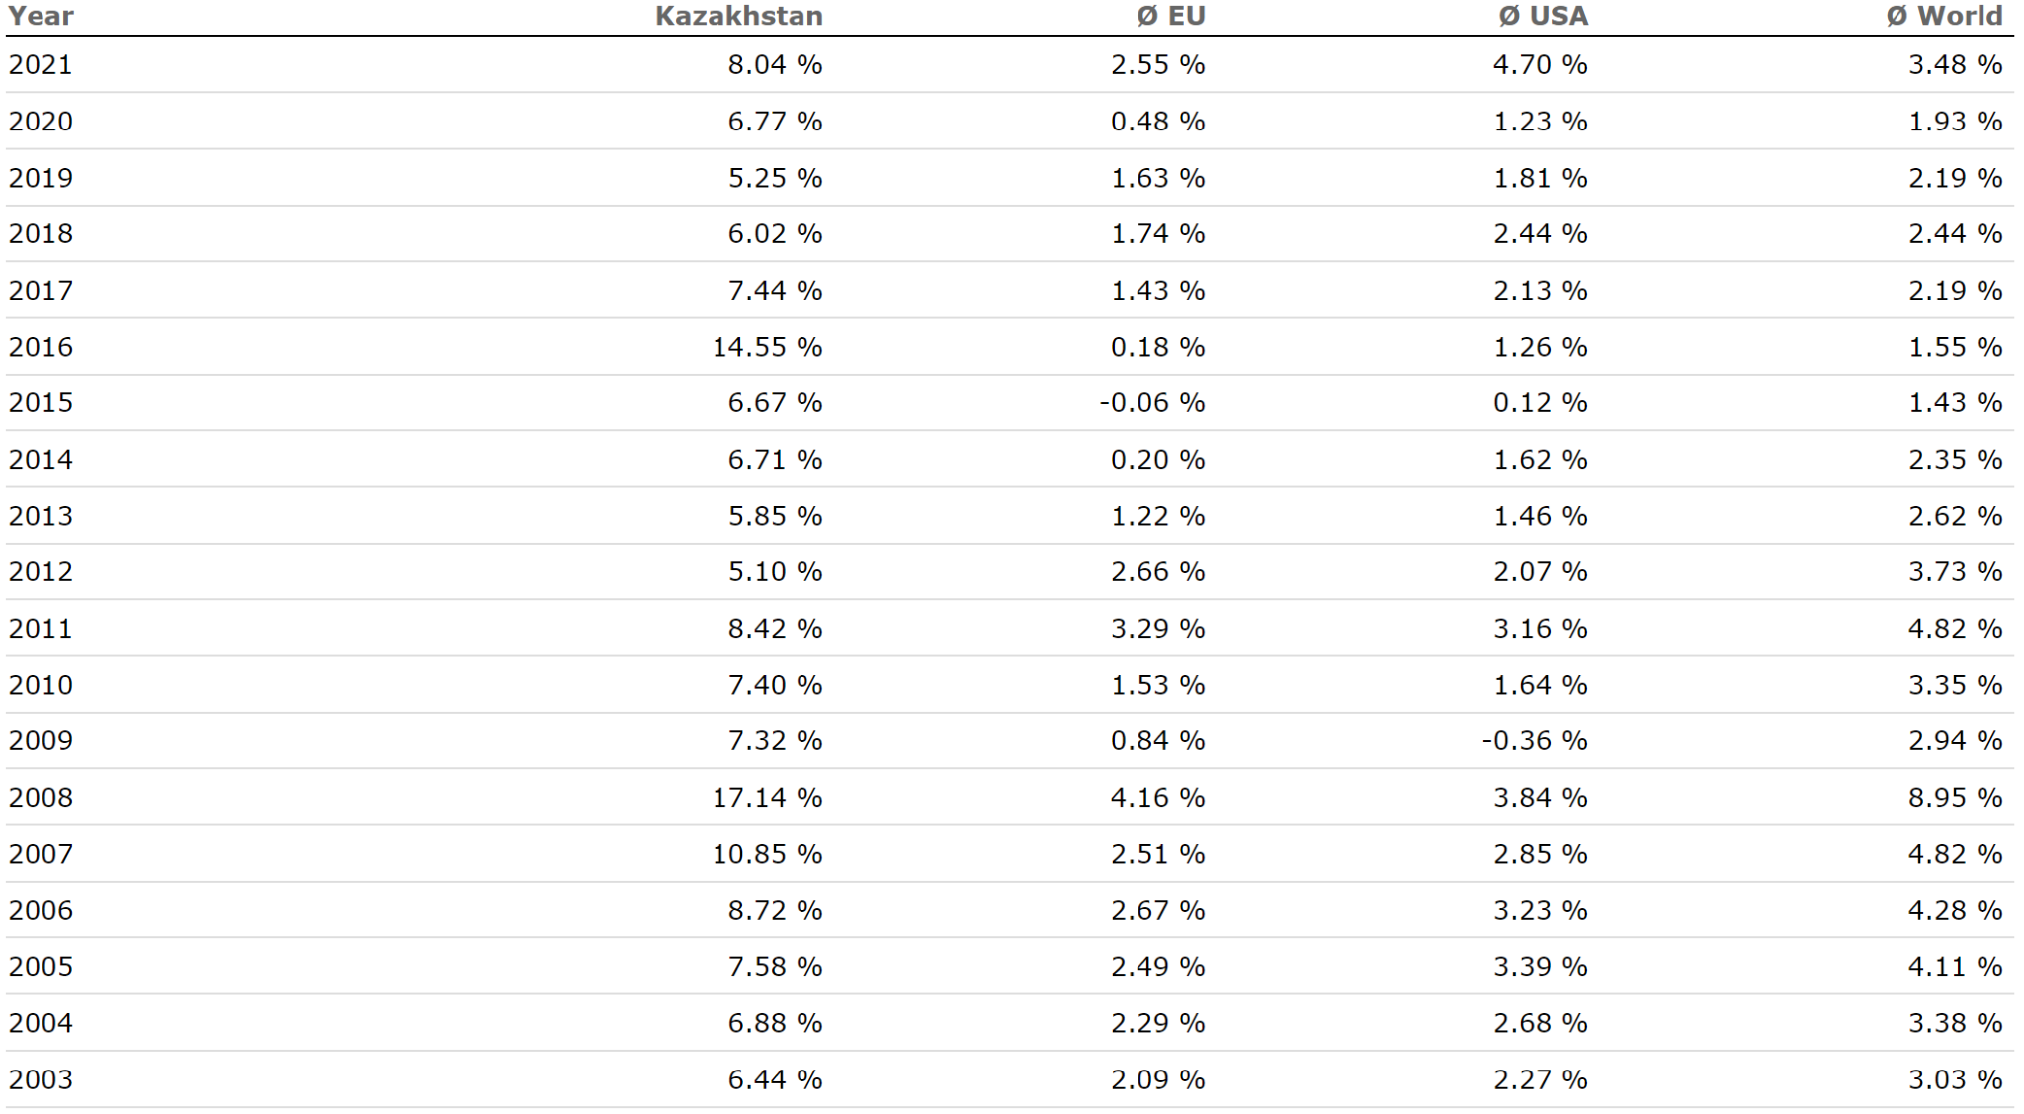
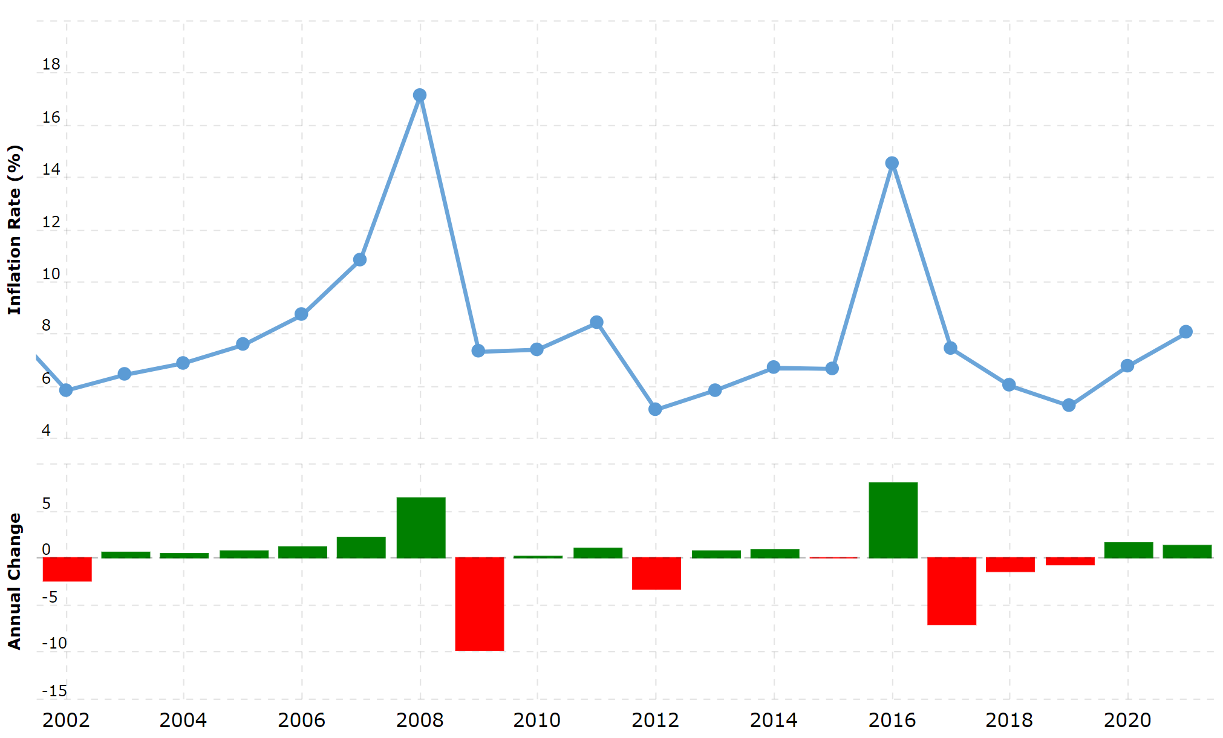
Kazakhstan’s Inflation

Slide 12
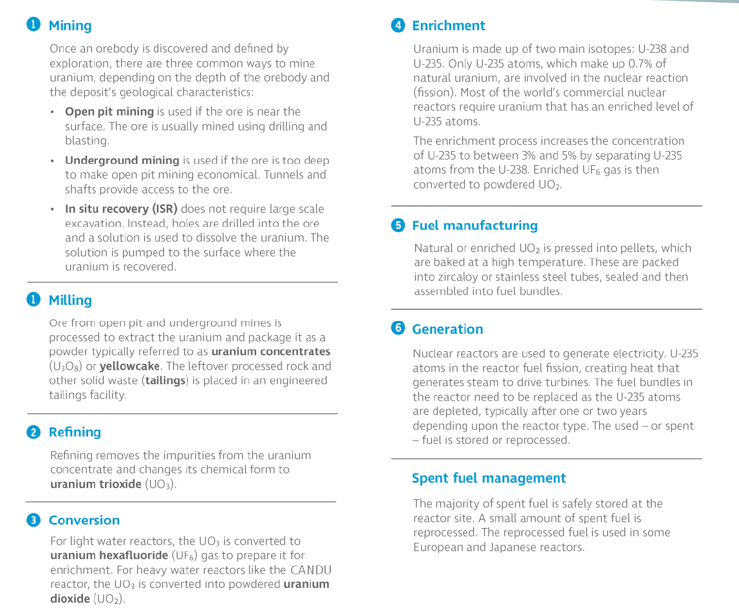
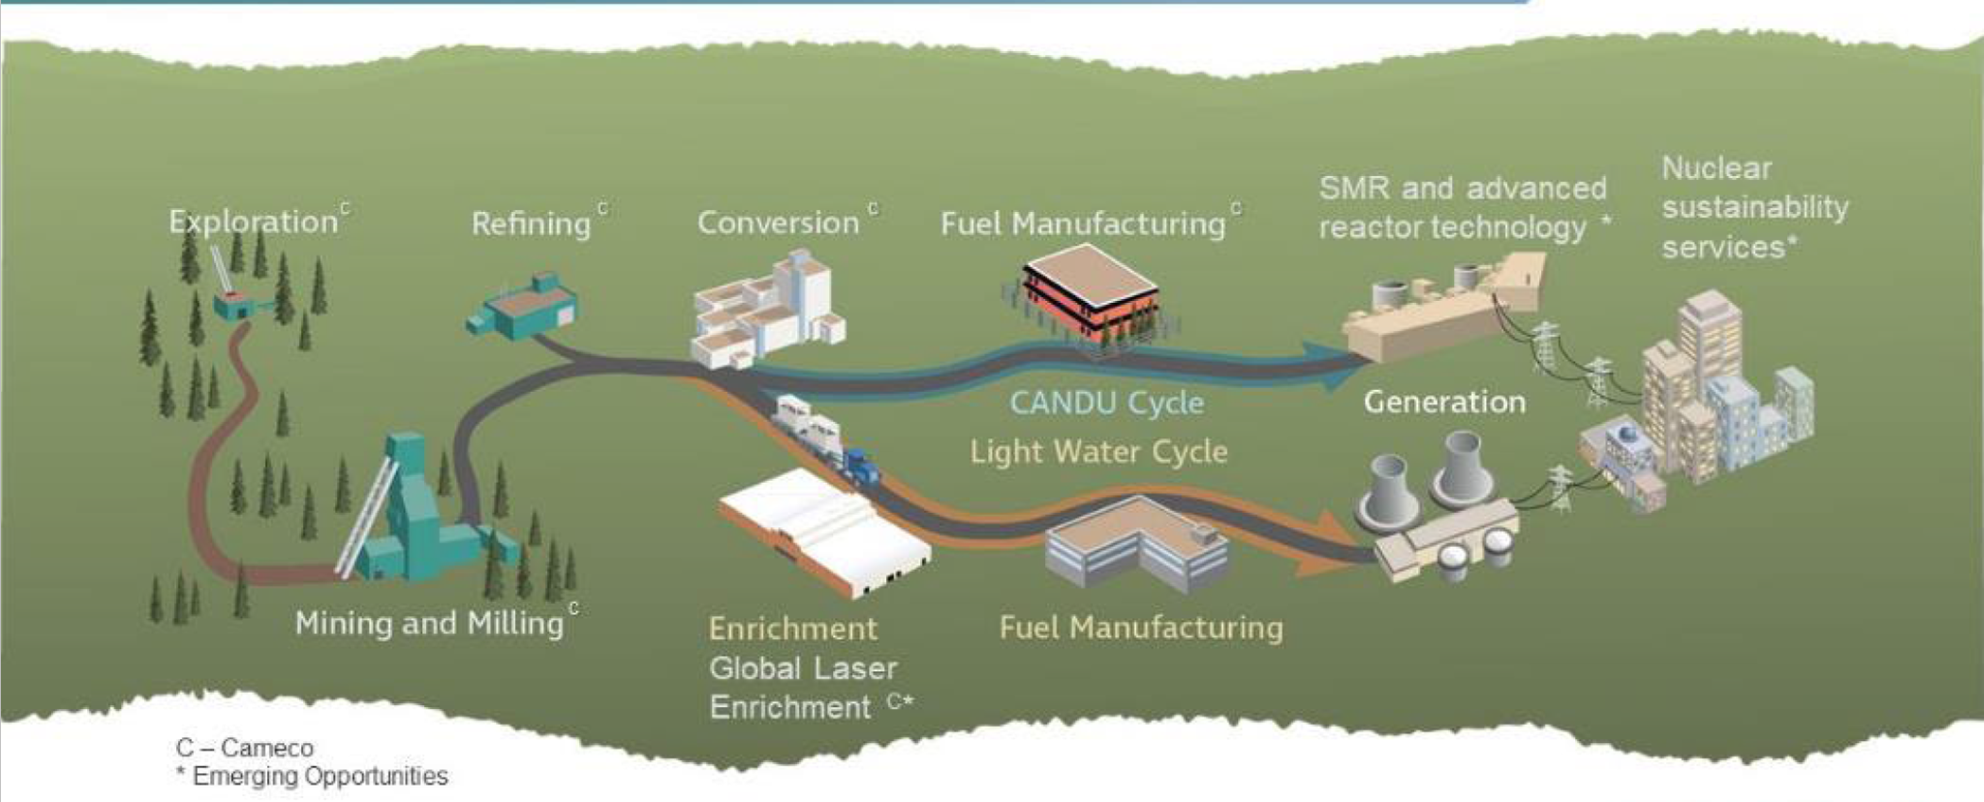
Nuclear Fuel Cycle

Slide 13
Industry Analysis
Uranium Mining

Slide 14
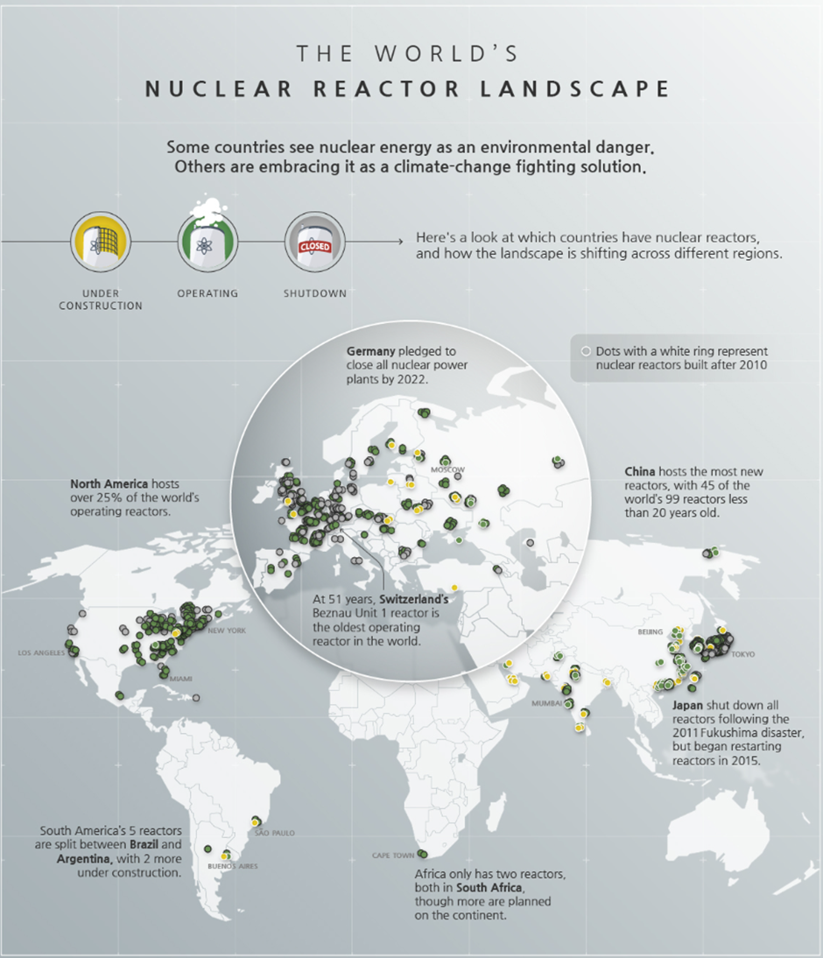
Current & Future Demand for Uranium?
Globally there are 439 operable reactors with 57 under construction 18 of which are in China.

Slide 15
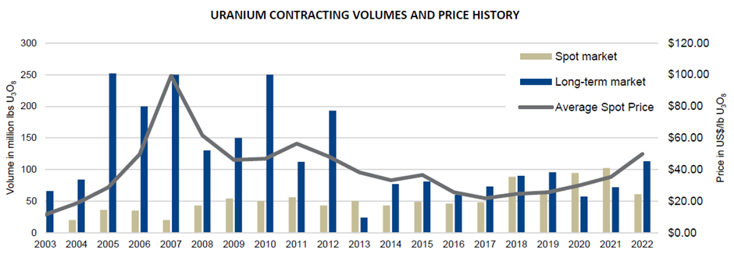
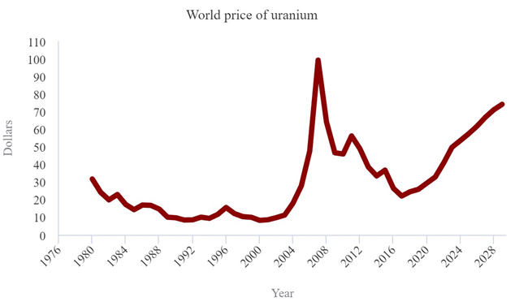

Slide 16
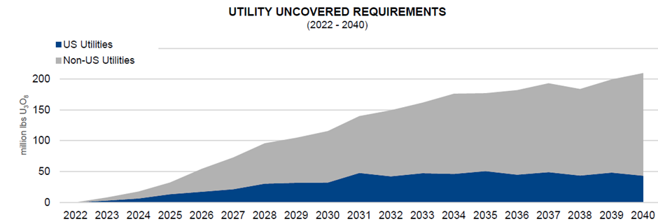
Opportunity for Business?
Cumulative uncovered requirements are about 2.3 billion pounds to the end of 2040. This backlog presents a substantial opportunity for proven and reliable suppliers with tier-one productive capacity

Slide 17
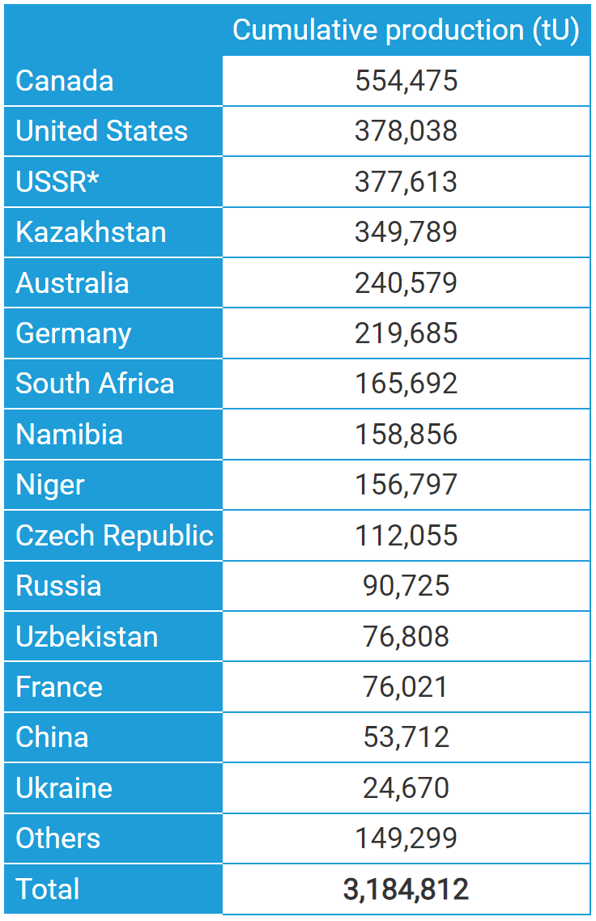
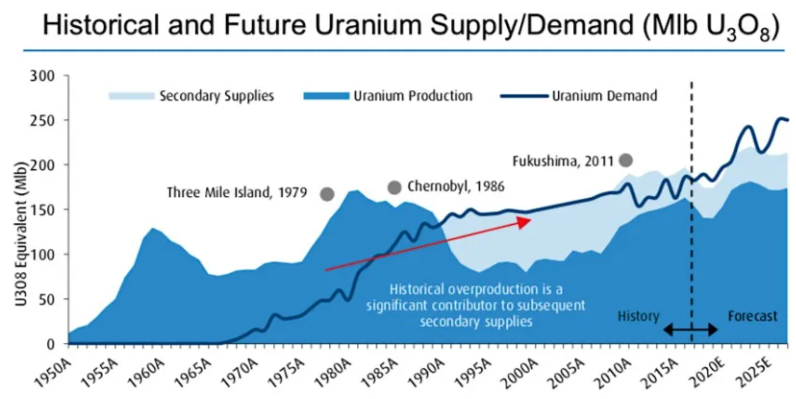
Where is the Supply coming from?
Notes:
Secondary supplies, in all of their forms, are huge, as they include all uranium mined and processed in the past for both military and commercial purposes, which has not been consumed.

Slide 18
Future Demand Issues?
About 440 reactors with combined capacity of about 390 GWe require some 74,000 tonnes of uranium oxide concentrate containing about 62,500 tonnes of uranium (tU) from mines each year.
The capacity is growing slowly, and at the same time the reactors are being run more productively, with higher capacity factors, and reactor power levels.
Factors increasing fuel demand are offset by a trend for increased efficiencies, so demand is dampened – over the 20 years from 1970 there was a 25% reduction in uranium demand per kWh output in Europe due to such improvements, which continue today.

Slide 19
However,
Demand for uranium fuel is much more predictable than with probably any other mineral commodity.
Once reactors are built, it is very cost-effective to keep them running at high capacity and for utilities to make any adjustments to load trends by cutting back on fossil fuel use.
Demand forecasts for uranium thus depend largely on installed and operable capacity, regardless of economic fluctuations.

Slide 20
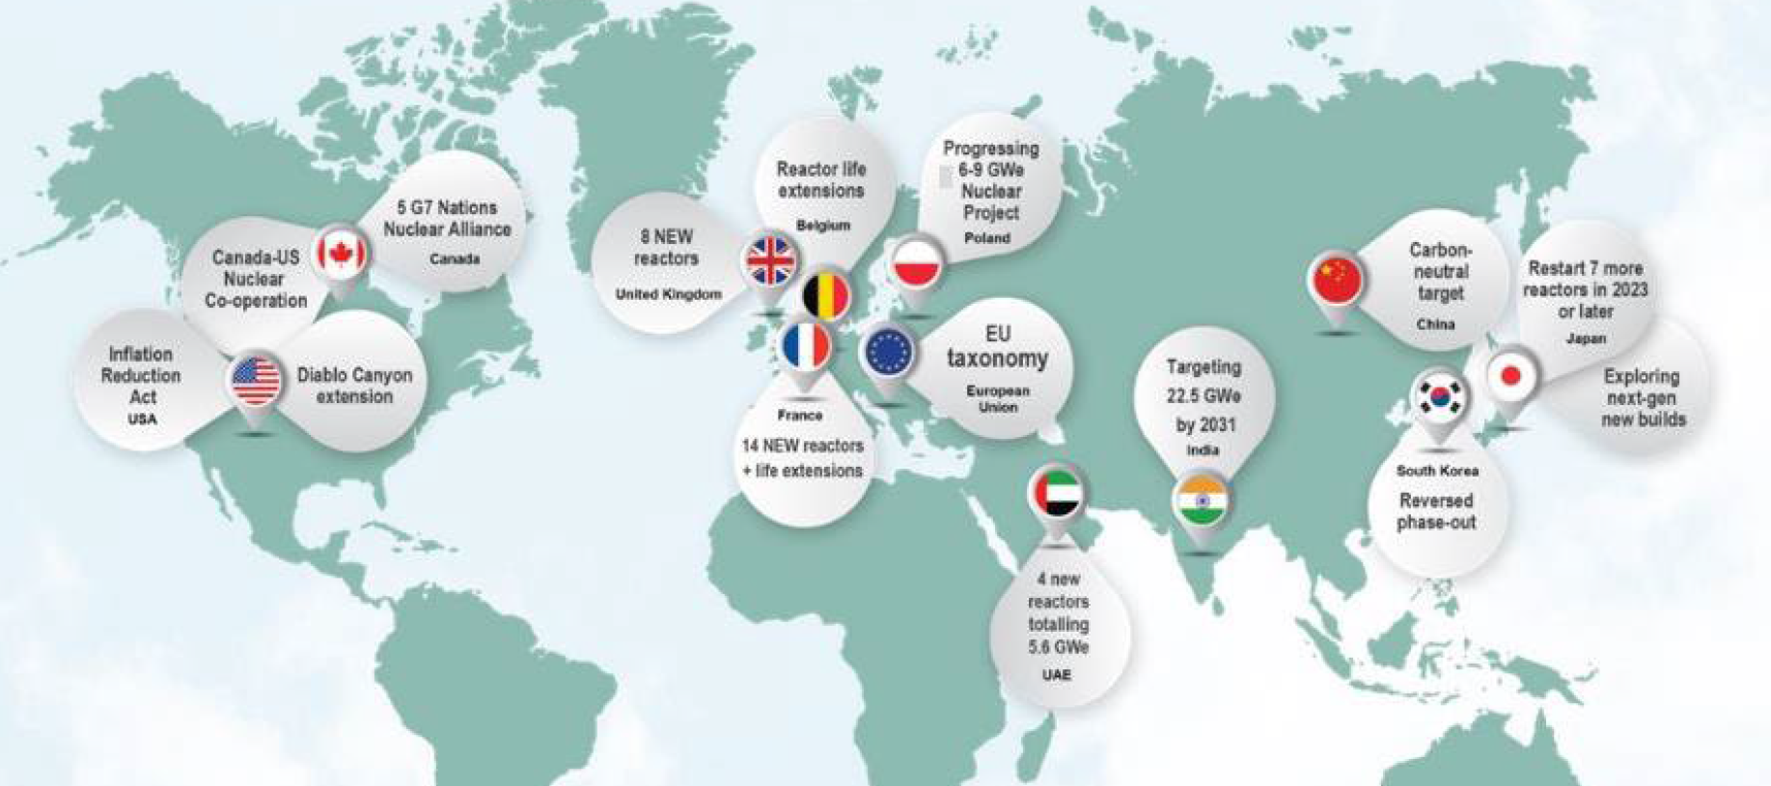
Growing Support for Nuclear

Slide 21
Consequently, New Nuclear Initiatives
At the end of August, India's first indigenously developed nuclear power plant, Kakrapar Unit 3, began operating at full capacity.
On August 30, Egypt’s regulatory authority approved final plans for a fourth 1,200 MWe reactor at El Dabaa Nuclear Power Plant.
In November 2022, the UK announced that it would take a joint stake alongside French partner EDF in the construction of its new Sizewell C nuclear power station, replacing China General Nuclear 20% stake
Tokyo Electric Power Company (TEPCO) announced on August 22 that Japan’s government approved plans and issued its final decision allowing TEPCO to begin discharging treated water into the Pacific Ocean from storage at the Fukushima Daiichi nuclear power plant in Fukushima Prefecture, Japan.

Slide 22
Few more…
Mexico's Laguna Verde nuclear plant has been granted 30-year operating life extensions for its two units.
Canada, Ontario Power Generation (OPG) announced plans to extend the life of the Pickering nuclear power plant until at least 2026 and potentially up to 30 years.
China announced plans to accelerate new nuclear projects to combat future electricity shortages, indicating it could raise the number of new reactor construction approvals to ten or more per year. In 2022, there were ten approvals.
In Romania, it was announced on September 19 that the Canadian federal government would support Romania’s energy security through a $3 billion export financing commitment to the country’s nuclear utility Nuclearelectrica SA.

Slide 23
Company Description
Cameco Corporation

Slide 24
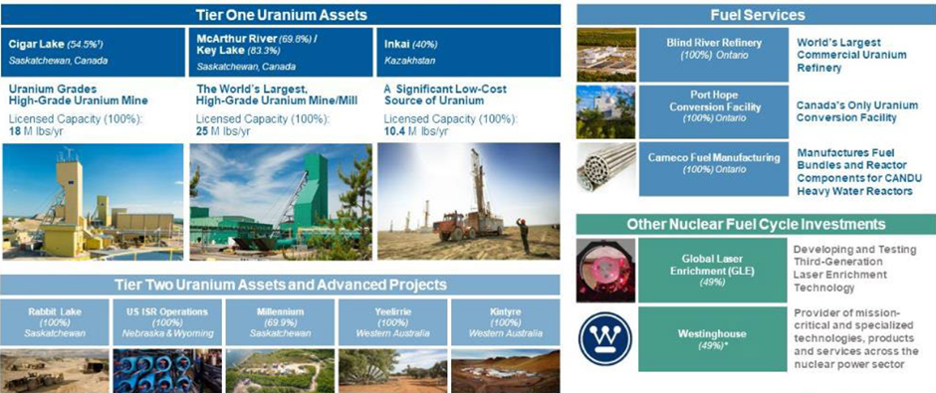
Products to Offer

Slide 25
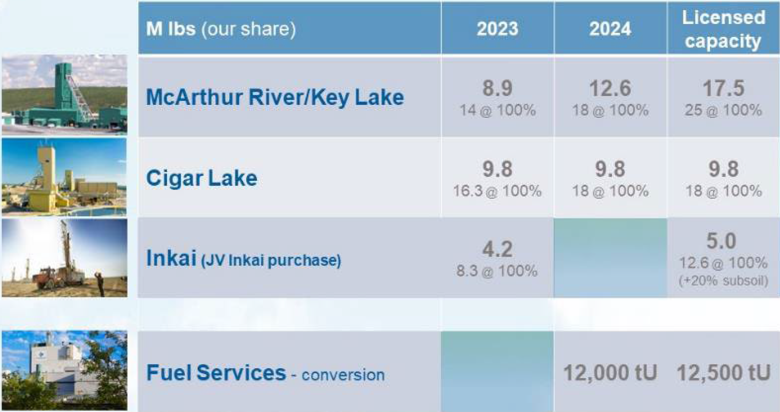
Mines & Projects

Slide 26
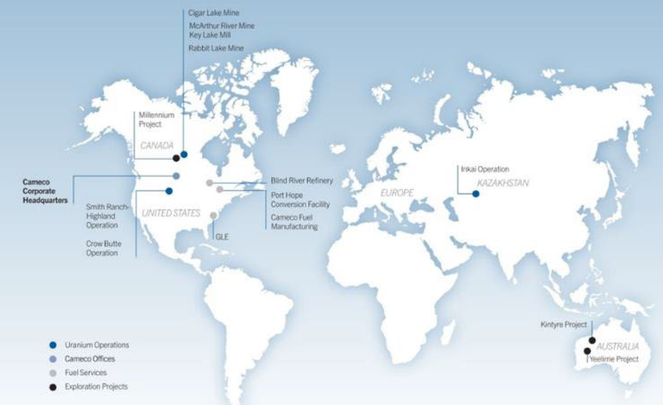
Locations of Mines and Projects:

Slide 27
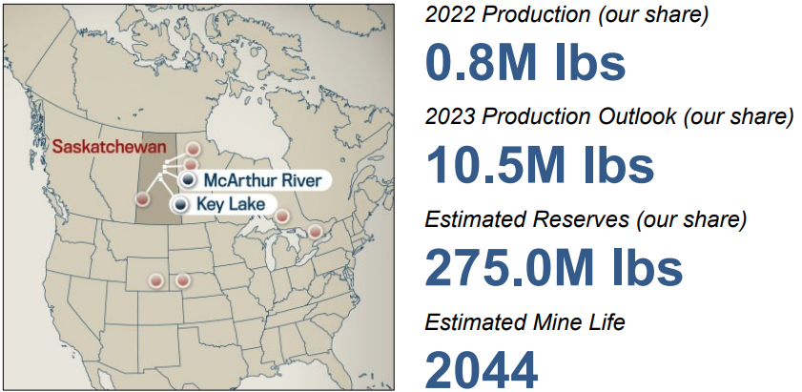
McArthur River Mine/ Key Lake Mill
McArthur River is the world’s largest, high-grade uranium mine, and Key Lake is the world’s largest uranium mill. Ore grades at the McArthur River mine are 100 times the world average.
Ownership: McArthur River - 69.805% Key Lake - 83.33%
Licensed Capacity: 25 million pounds per year

Slide 28
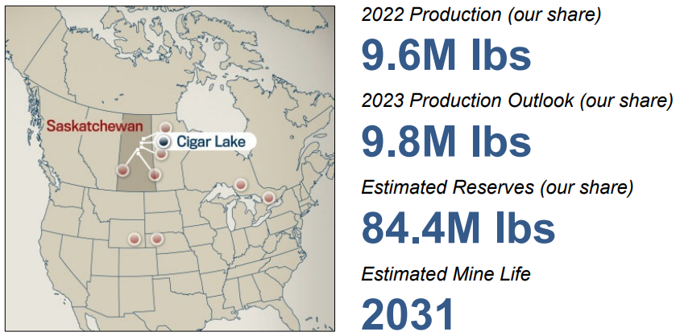
Cigar Lake
Cigar Lake is the world’s highest grade uranium mine, with grades that are 100 times the world average. 54.5% ownership and the mine operator. Cigar Lake uranium is milled at Orano’s McClean Lake mill.
Licensed Capacity: 18 million pounds per year, CCJ’s Share 9.8 million pounds

Slide 29
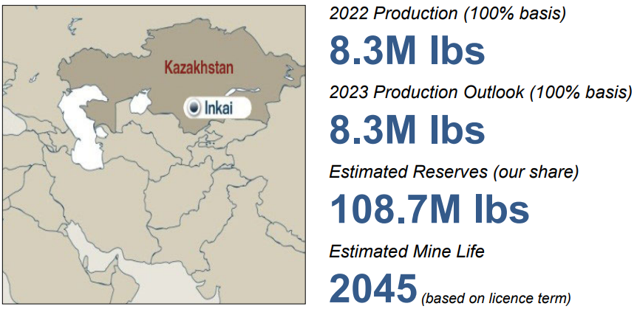
JV Inkai
Inkai is a very significant uranium deposit, located in Kazakhstan. The operator is JV Inkai limited liability partnership, which CCJ jointly owns (40%) with Kazatomprom (60%).
Licensed Capacity: 10.4 million pounds per year, CCJ’s Share 4.2 million pounds

Slide 30
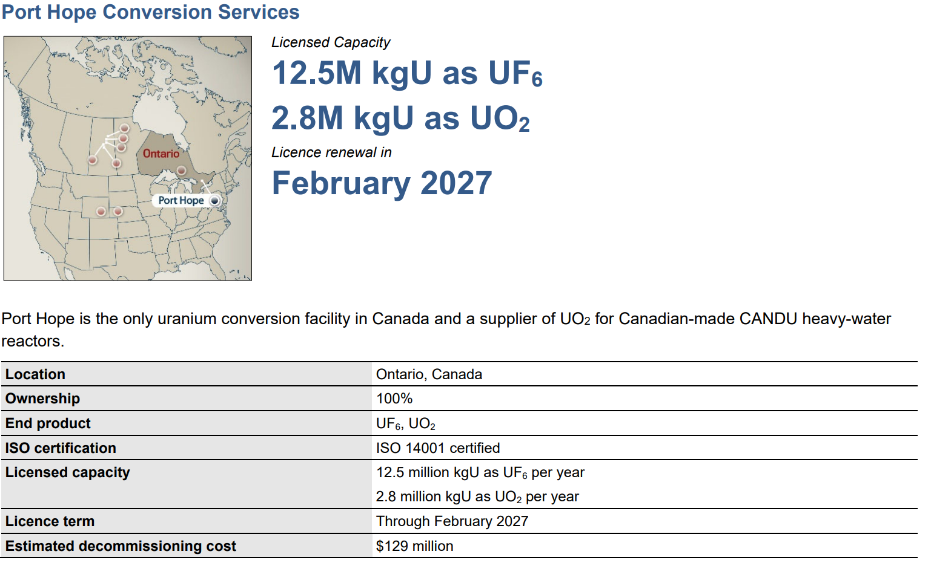
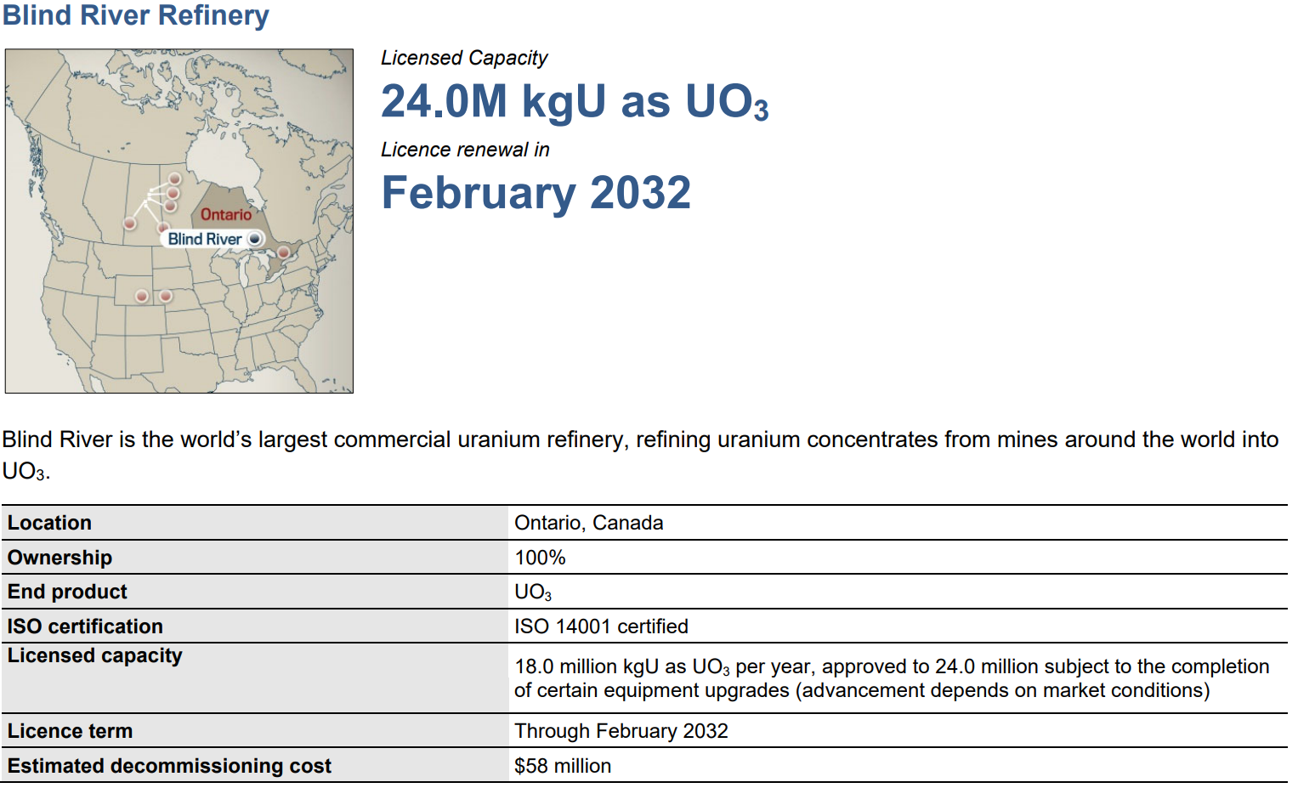
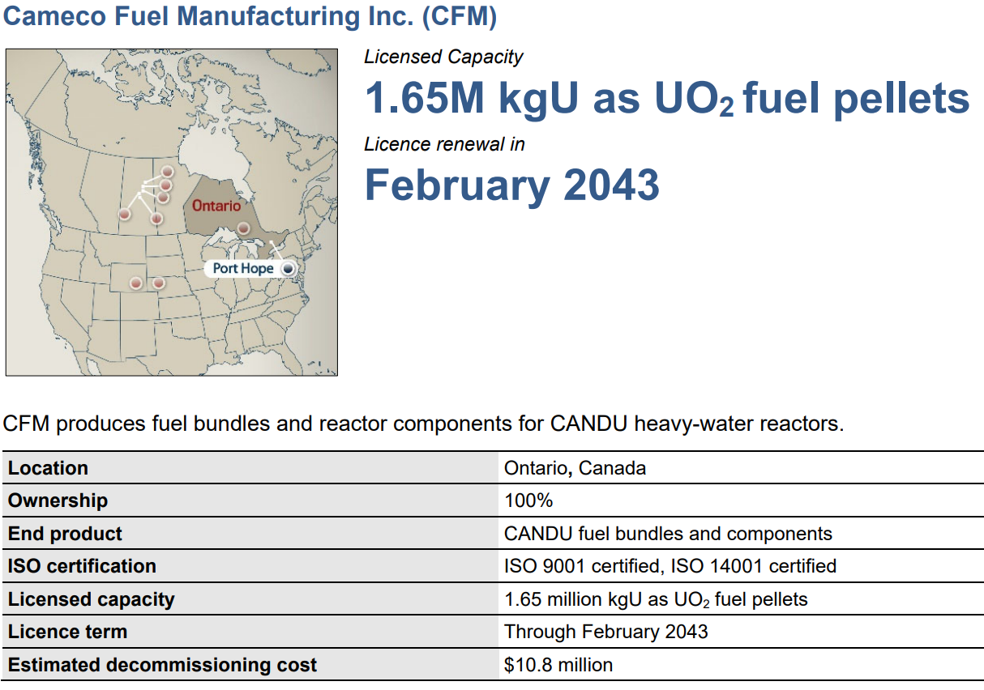
Fuel Services

Slide 31
Main Risks
Demand and Supply both are expected to increase but not at the same rate due to prolonged production constraints.
Low prices of uranium caused by supply curtailment, end of reserve life and lack of investment in supply.
Production costs are also up due to inflationary pressures, leading to challenges when building new mines or maintaining current.
Origin risk: geopolitical and trade policy issues
Development risk: unproven assets, cost inflation & schedule delays from global supply chains, increasing regulatory and ESG scrutiny.

Slide 32
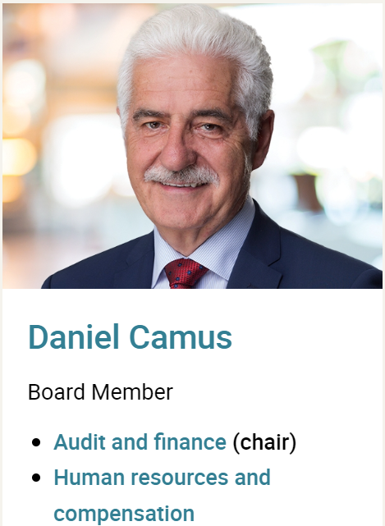

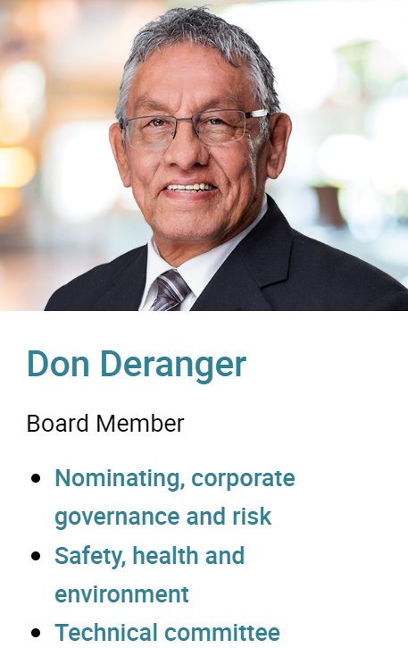
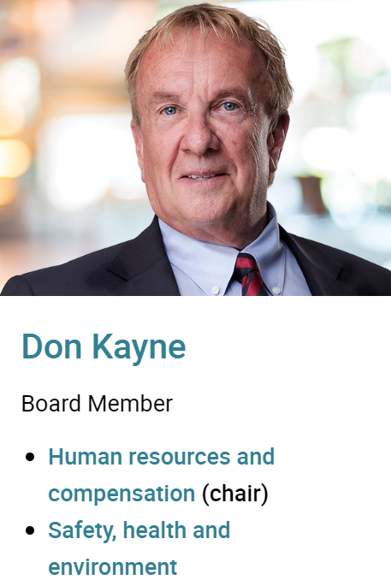


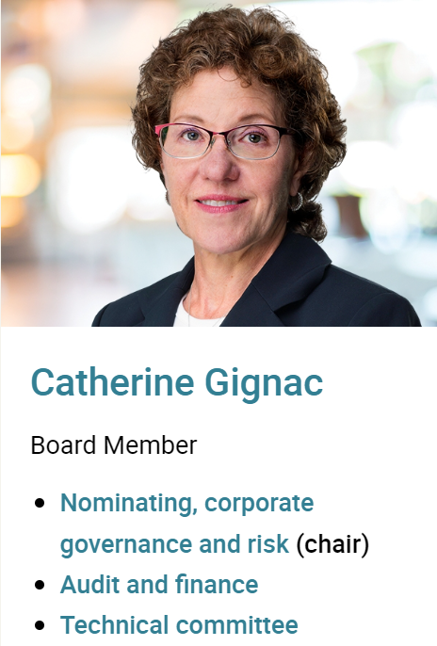



CCJ’s Board of Directors

Slide 33
Financials & Valuation
Cameco Corporation

Slide 34
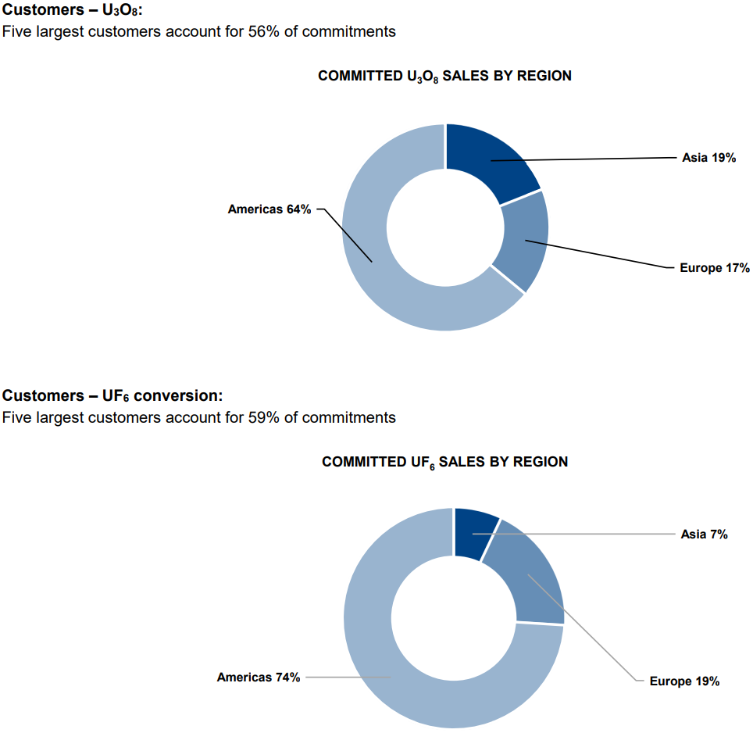
Customers for Uranium & Fuel Services

Slide 35
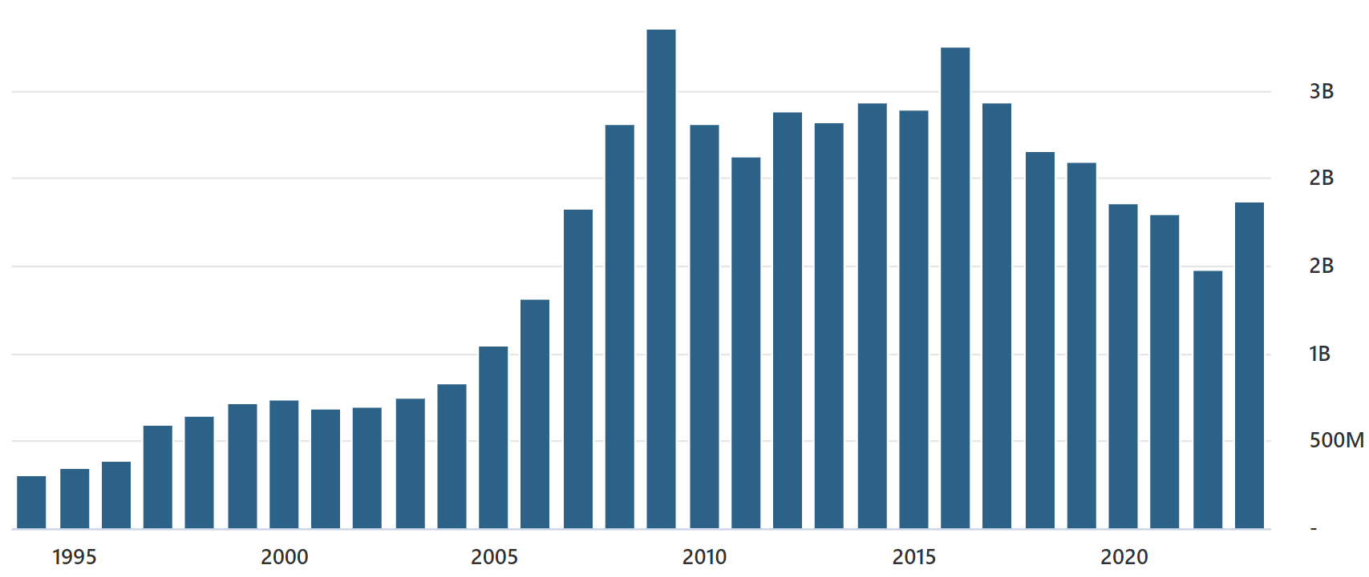
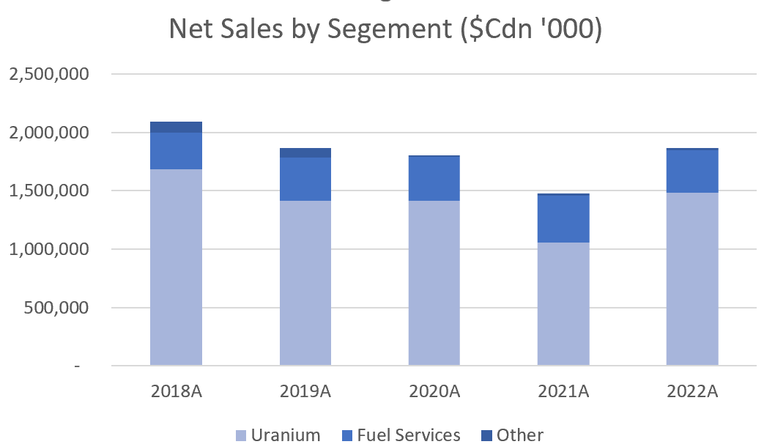
CCJ’s Revenue
CCJ Annual Revenue over the years

Slide 36
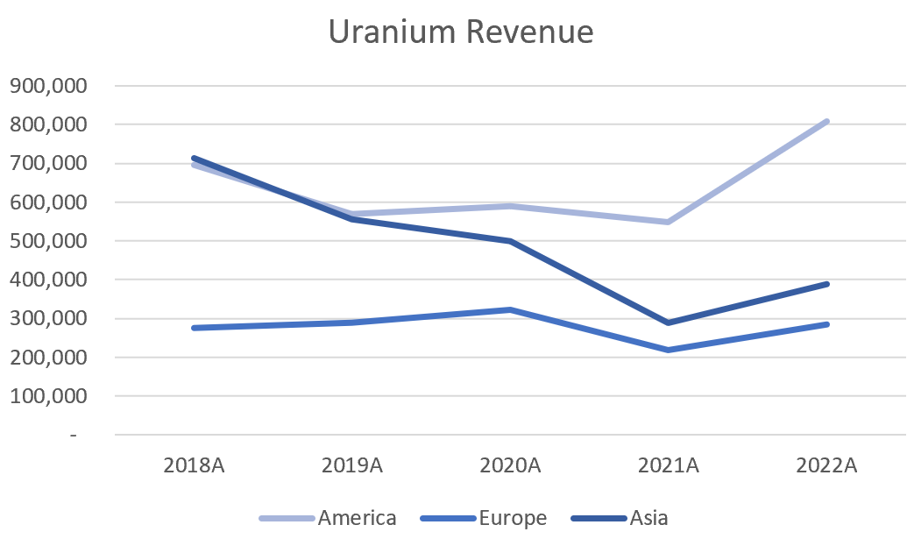
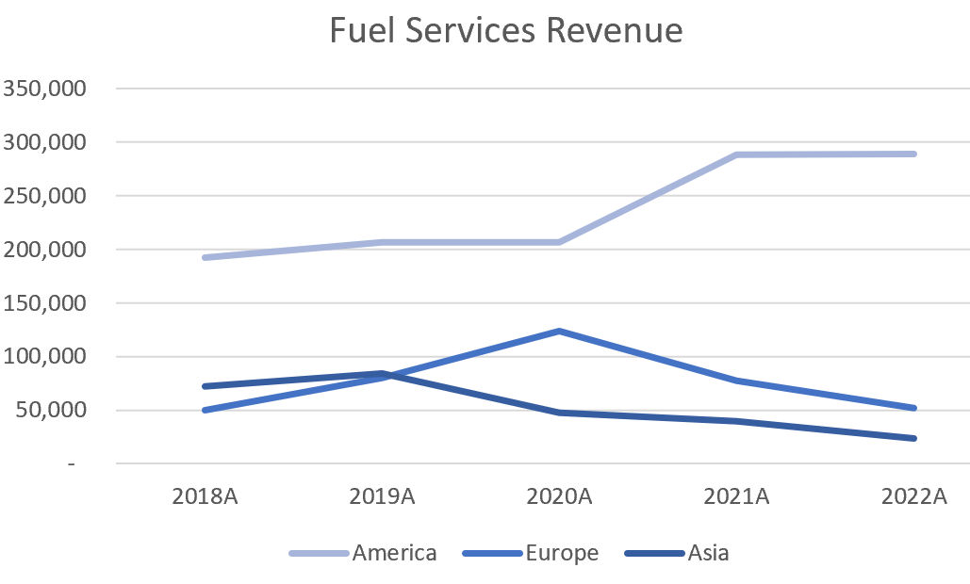
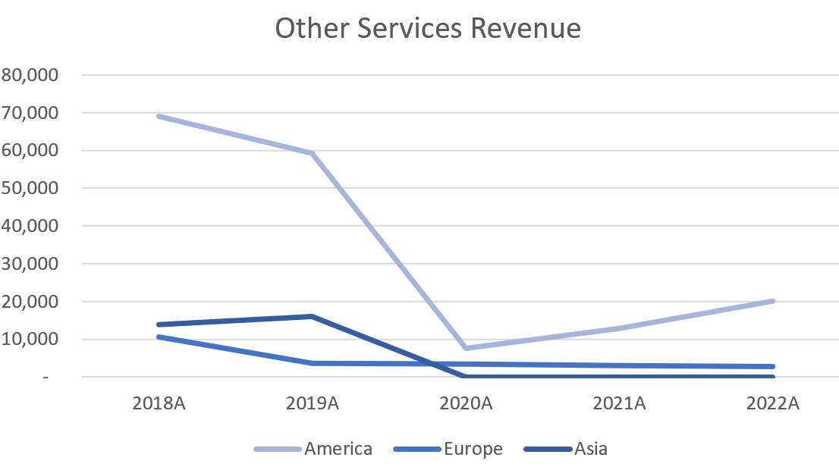
Revenue by Geographic Areas

Slide 37
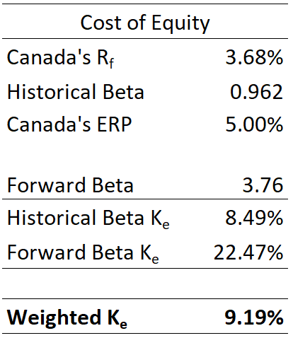
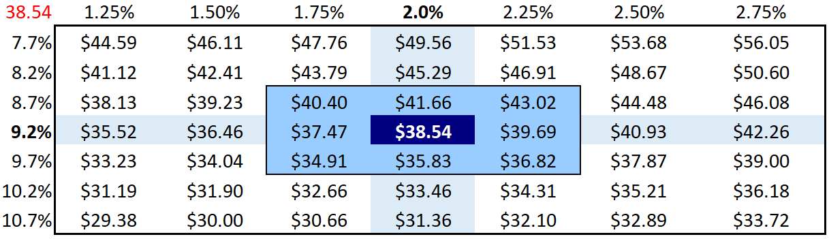
Best Case & Cost of Equity
Best case scenario with only changes to revenue:
Achieves 22.39% CAGR in revenues with significant increases from Uranium revenues with a steady revenue from Fuel services when compared with the base case.
Valuation price: $47.73 (8.14% value appreciation)

Slide 38
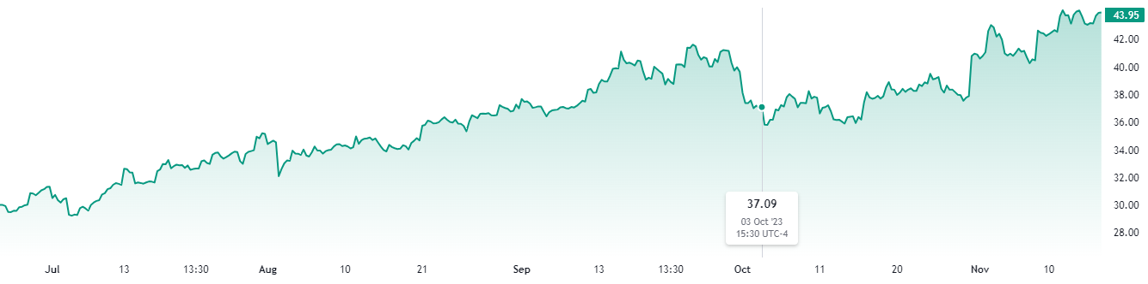
BUY?
Current Price: $43.75
Next 5 year Growth Estimates: 53.25%
Best Case with only revenue growth: $47.73
CAGR ≈ 22%
Model Price: $38.54
Next 6 year Growth used ≈ 18.36%

Slide 39
Appendix

Slide 40
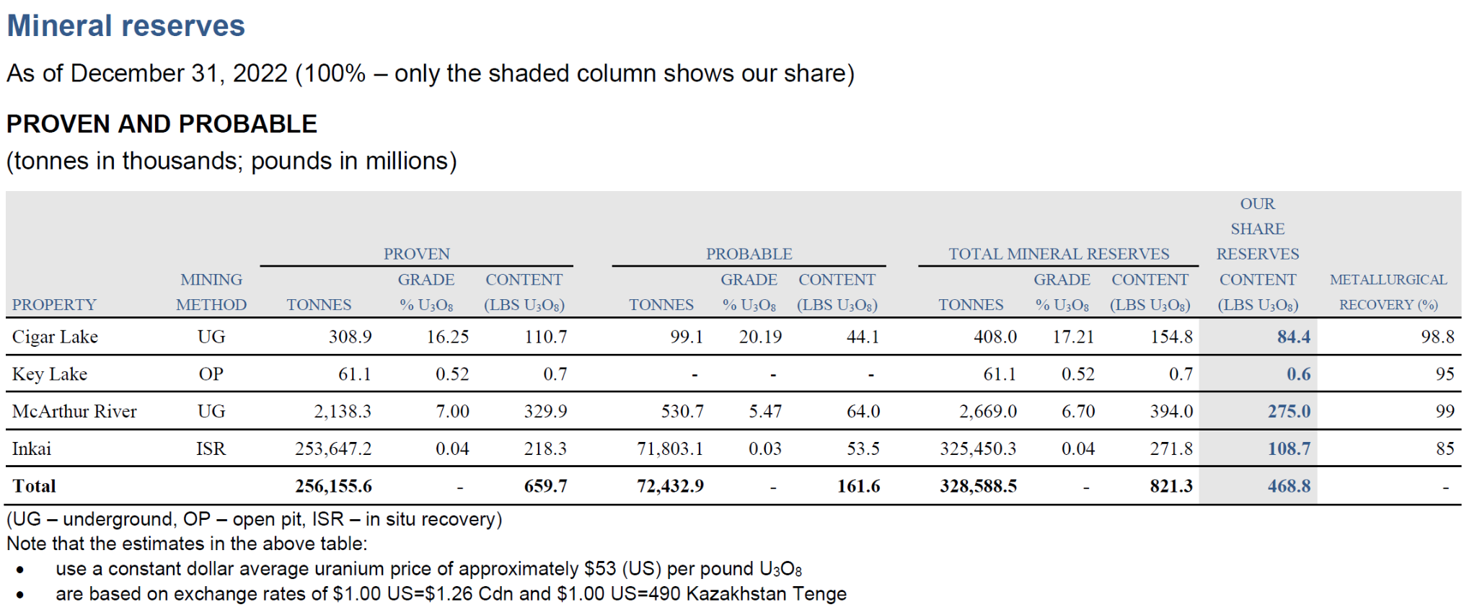
Proven & Probable Reserves

Slide 41
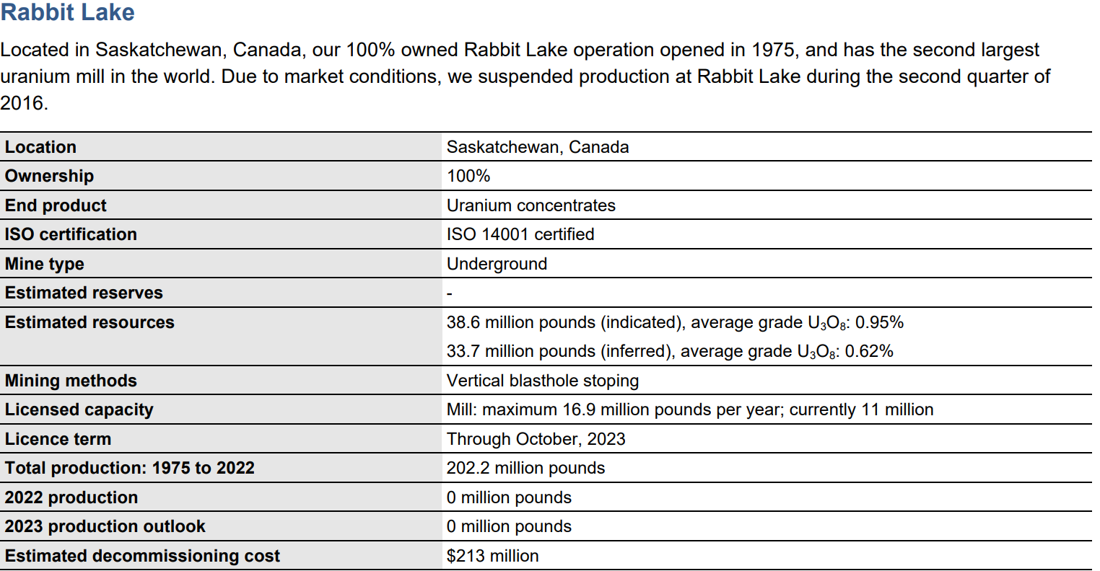
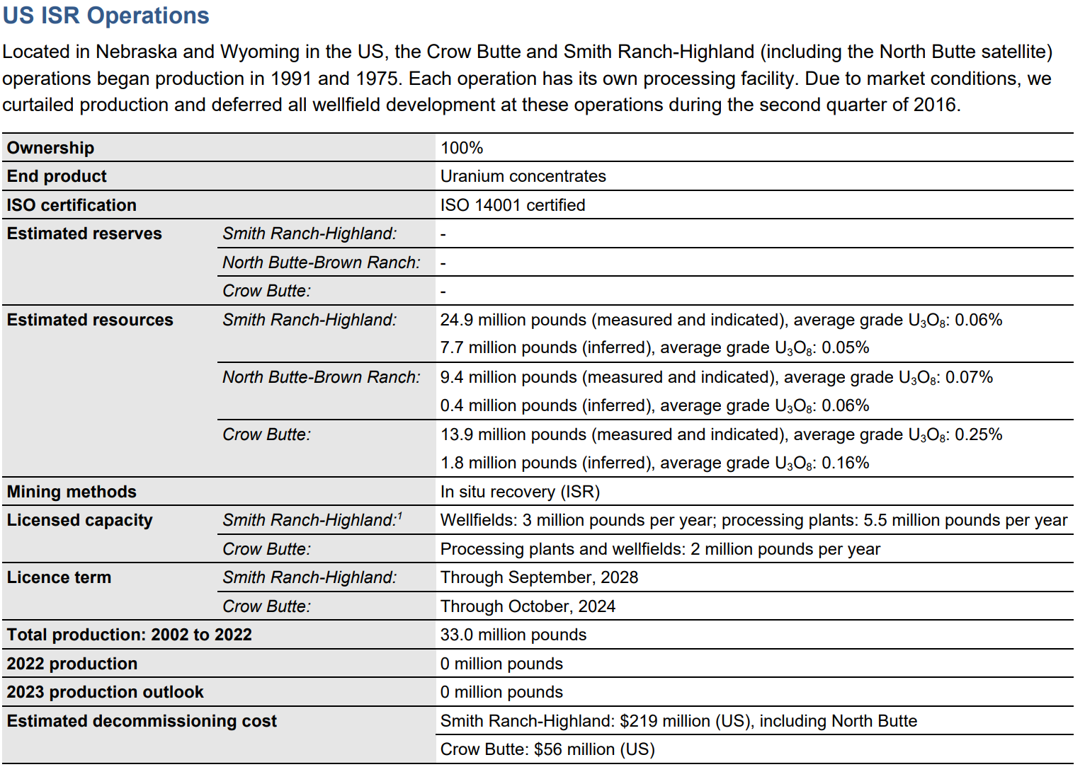
Tier 2 Uranium Operations - Currently Suspended

Slide 42
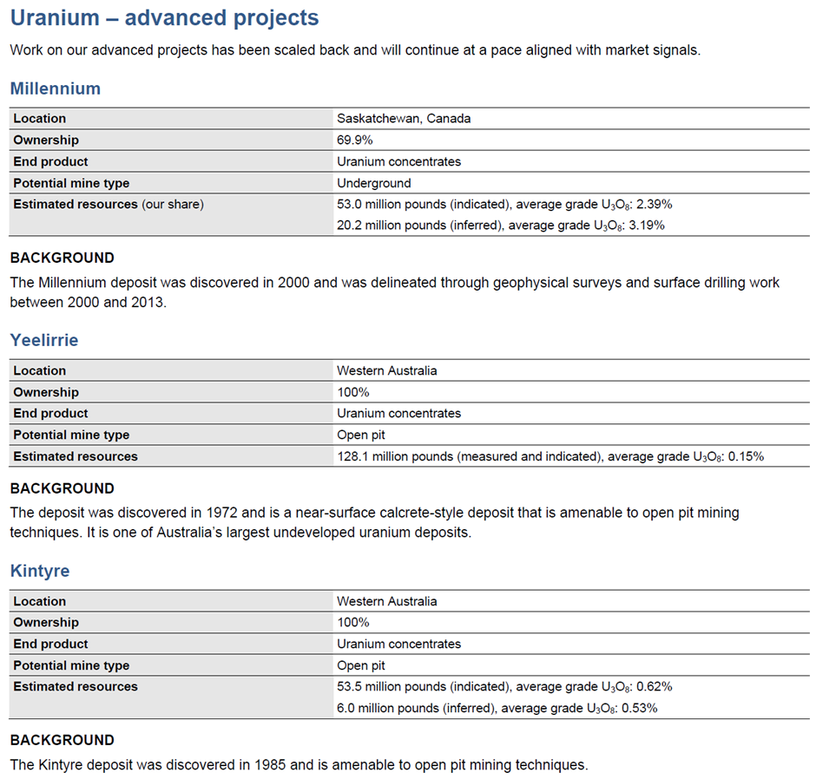
Advanced Projects

